Slide 1
State v Migrations

Slide 2
State Based Database Development
Capture the “state” of all code at a point in time (a snapshot)
Compare this state with another version of this state
Can be database to database
Can be VCS to database
Use the comparison to generate a script that will deploy changes from one version to the next.

Slide 3
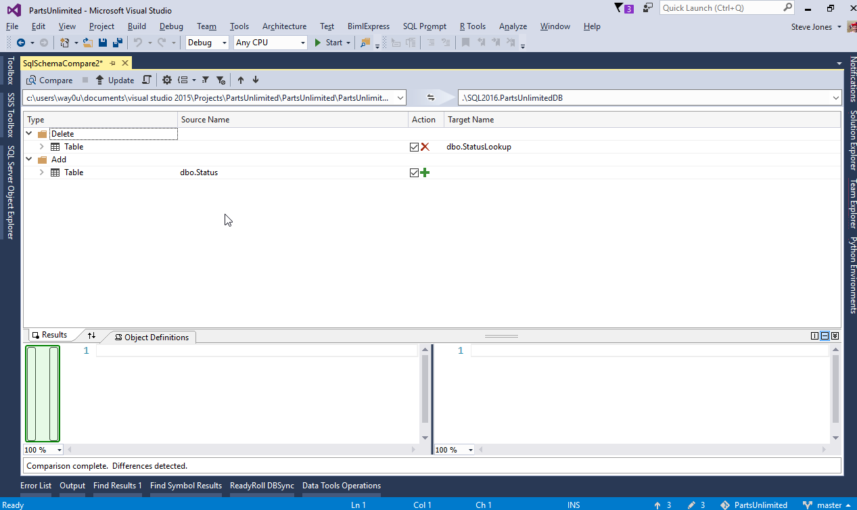

Slide 4
State Based Database Development
Pros
Simple for developers, nothing to track
Transient changes (those not needed) are not transferred
Branching and merging is (relatively) easy
Simplicity
Cons
Some changes cannot be captured with snapshot comparisons
Upgrades of databases tend to require known starting/ending points.
Multiple versions of databases are not easily upgraded

Slide 5
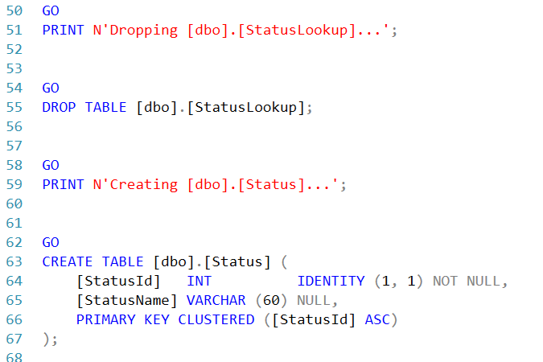
Generated script for table rename

Slide 6
Migration Based Database Development
All changes made to a database are tracked as they are made.
Changes are ordered and executed in the same order on downstream environments
The actual code a developer executes is replayed in downstream environments.

Slide 7
Migration Based Database Development
Pros
The exact code is executed in all environments, ensuring repeatability and reliability.
Any version of a database can be upgraded to any other version
Cons
Changes need to be tracked
Ordering is important and merging branches of development can be complex

